Slide 1
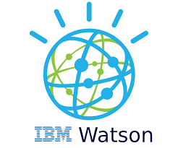
Segmentation project
May 2021

Slide 2
introduction
Background
Toronto is the capital city of the Canadian province of Ontario. With a recorded population of 2,731,571 in 2016. it is the most populous city in Canada and the fourth most populous city in North America. The city is the anchor of the Golden Horseshoe, an urban agglomeration of 9,245,438 people (as of 2016) surrounding the western end of Lake Ontario,[15] while the Greater Toronto Area (GTA) proper had a 2016 population of 6,417,516. Toronto is an international centre of business, finance, arts, and culture, and is recognized as one of the most multicultural and cosmopolitan cities in the world.

Slide 3
introduction
Problem Description:
In this Capstone project, I am trying to faciltate the way for anyone like to change his neighborhood within in the same city, Toronto. Many reasons push people to change their neighborhood like having a new job offers.To take this decision, people need to know how to replace all the places they use for having a normal life like they used to have. This normal life should incude schools, parks , pharmacies and resturants.
Objective
The aim of this project is to study and analyze the neighborhoods of Toronto city and group them into similar clusters.

Slide 4
introduction
Data Section:
a) Toronto Neighborhood Data: https://en.wikipedia.org/wiki/List_of_postal_codes_of_Canada:_M
b) Coordinate data for each Neighborhood in Toronto: http://cocl.us/Geospatial_dataObjective

Slide 5
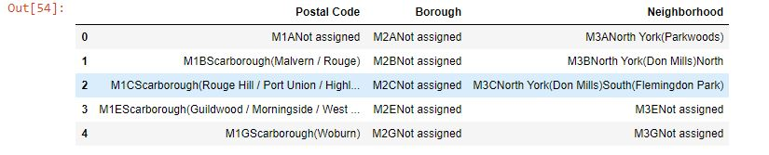
methodology
1. Scrape Toronto Neighborhood Data from Wikipedia
BeautifulSoup was used to Scrape the data into the dataframe shown below.

Slide 6
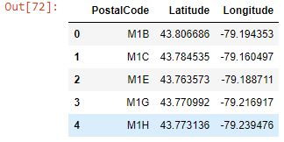
methodology
Also, Coordinate data for all Toronto neighborhoods were collected.

Slide 7
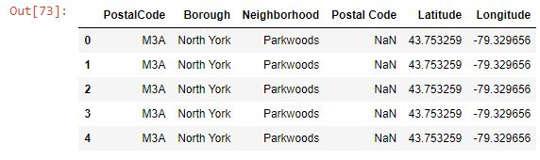
methodology
Coordinate data were added to the Toronto Neighborhood dataframe

Slide 8
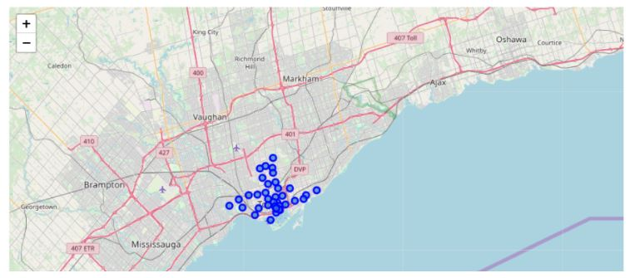
methodology
2. Generating a Toronto's Neighborhood data map

Slide 9
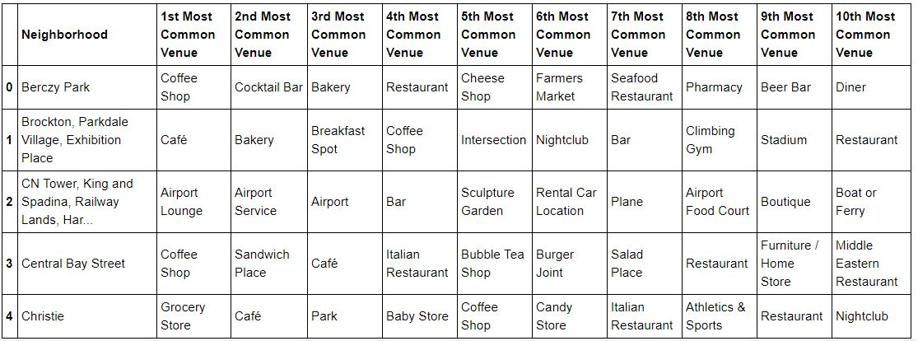
methodology
3. Using Foursquare API
The neighborhood was used to group data, and find out the top ten venues present in each neighborhood.

Slide 10
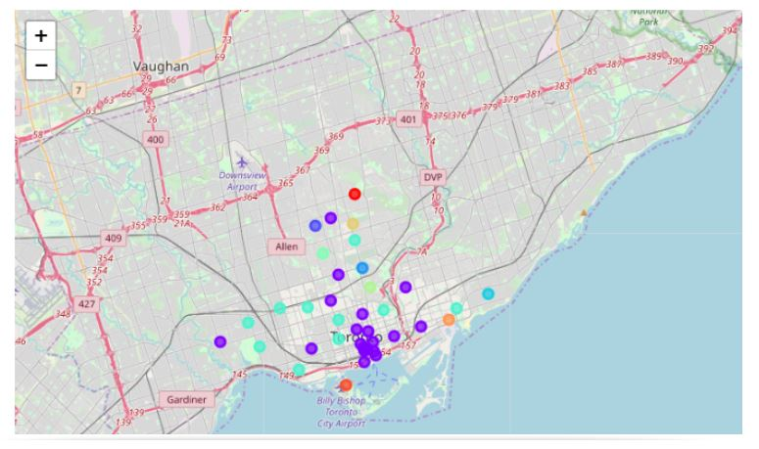
results
The data are clustered and visualized using the matplotlib and folium packages .

